Slide 1
MLA Citation

Slide 2
In-text citation review
1. Author’s name & page number in parenthesis.
2. Introduce, Cite, and Explain.
3. Ellipses for skipped words.
4. Indent for quotes longer than 4 lines
5. Bracket for replaced words.
6. Single quotation marks (‘ ‘) for a quote inside a quote

Slide 4
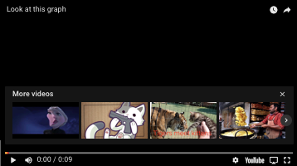

Slide 5
works cited page
What is a works cited page? (Sometimes called a Bibliography)
- A page found at the end of a paper that gives the credentials necessary to credit each source used in your essay
Why is a Works Cited Page necessary?
What information is required in a works cited page?
Author’s Last & First name, Title, Website, Date Published

Slide 6
Examples
Example #1 (Book)
Adams, Laurie. A History of Western Art. New York: H.N. Abrams, 1994.

Slide 7
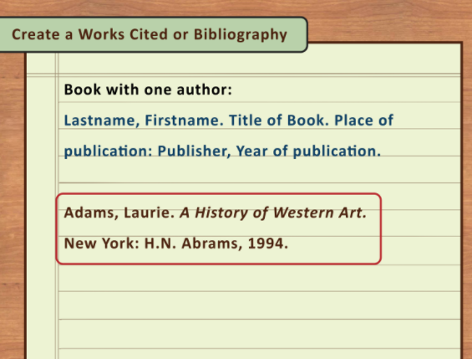

Slide 8
Examples
Example #2 (Website with no author)
“Fighting Resumes at Camp in Lebanon.” New York Times. New York Times, 1 June 2007. Web. 22 June 2007.

Slide 9
Website citation
“Fighting Resumes at Camp in Lebanon.” New York Times. New York Times, 1 June 2007. Web. 22 June 2007.
”Title of Article.” Title of Magazine, Newspaper, or Website. Publisher of Website, Date of Publication. Publication Medium. Date of Access.

Slide 10
Italics vs quotation marks
Italics =
Most often used for larger publications such as entire books, TV shows, plays, journals, magazines, etc.
“Quotation Marks” =
Most often used for smaller publications such as articles in a magazine, short poems, short stories, songs, book chapters, etc.

Slide 11
Practice
Go to google classroom and complete the “In text Citation” test by creating a new doc, copying and pasting the test, and writing your answer.

