Slide 1
The Victorian Era

Slide 2
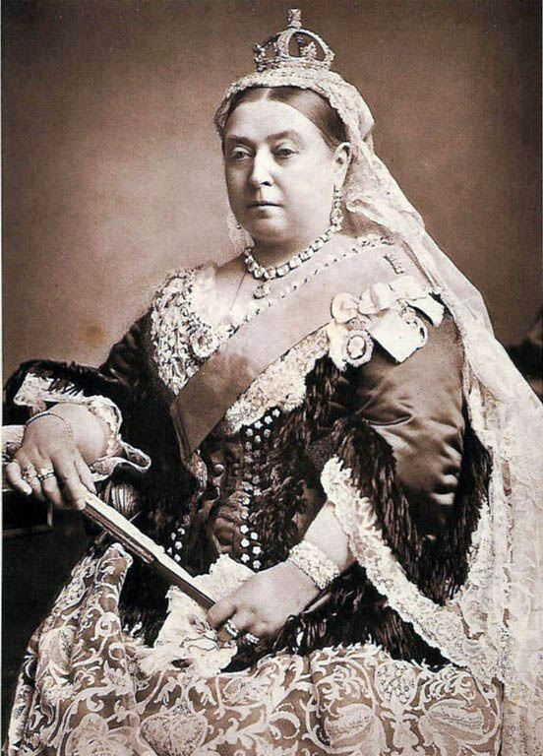
What is the Victorian Era?
Queen Victoria reigned from 1837 – 1901
Time of peace and prosperity generally (no war)
Population of England doubled
Increased poverty
Notes:
Was crowned queen after death of her grandfather, father, two uncles. Plunged into deep depression.

Slide 3
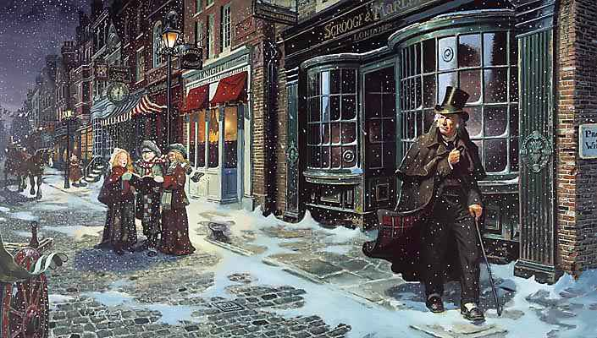
Victorian literature
The novel > poetry
Key authors: Charles Dickens, The Brontë sisters, Oscar Wilde.
Major Themes: death, disease, supernatural, poverty, mystery
Emphasis on morality
Why so many orphans?
Notes:
Why so obsessed with death?
Mourning outfits, death rituals and momentos,

Slide 4
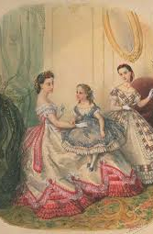
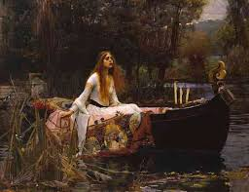

Slide 5
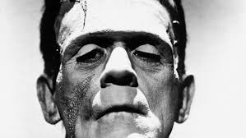
Gothic Literature
Paranormal phenomena
Clergymen
Omens
Maidens in distress

Slide 6
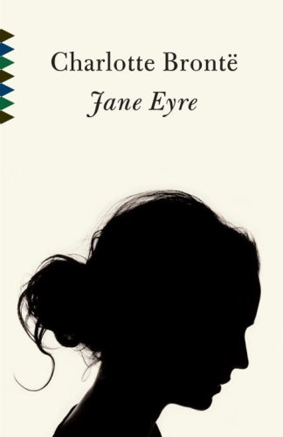
Victorian Era + Gothic Literature =
Victorian Gothic

Slide 7
Victorian gothic literature
No more helpless heroines and evil villains
More relatability and believability
Spiritualism
Communication between the dead and the living

Slide 8
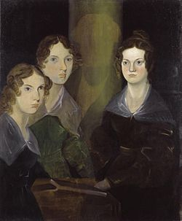
Charlotte Bronte
The Brontë sisters: Anne, Emily, and Charlotte
All wrote under male pseudonyms (pen names)
Lived in relative isolation
Cowan Bridge School after mother’s death
Three older sisters died at the school

Slide 9
The Victorian Woman

Slide 10
The Victorian Woman

Slide 11
A Controversial Victorian Heroine
Charlotte Brontë once told her sisters that they were wrong—even morally wrong—in making their heroines beautiful as a matter of course. They replied that it was impossible to make a heroine interesting on any other terms. Her answer was, 'I will prove to you that you are wrong; I will show you a heroine as plain and as small as myself, who shall be as interesting as any of yours.'"
Notes:
What does this reveal about Bronte’s intention for her chracter Jane? How do you guess she would be “interesting on other terms?”

