Slide 1
SOAP

Slide 2
Speaker
The voice that tells the story
Not necessarily who wrote it, but who is saying it (the narrator, not author)
Questions to ask yourself:
What is their tone?
How does who is speaking influence the text?
What common words or syntax do you see in their writing?

Slide 3
Occasion
The time and place of the piece
The context that prompted the writing
Questions to ask yourself:
What important event inspired this speech?
Consider the larger occasion as well as the immediate occasion.

Slide 4
Audience
The group of readers to whom this piece is directed
Questions to ask yourself:
How does the speaker alter what they say to reach this specific audience?
What parts of the speech will be most important to this audience?

Slide 5
Purpose
The reason behind the text
Questions to ask yourself:
What does the speaker want the audience to think or do as a result of reading the speech?
What is the speaker’s goal?
(To inform, persuade, entertain, etc.)

Slide 6
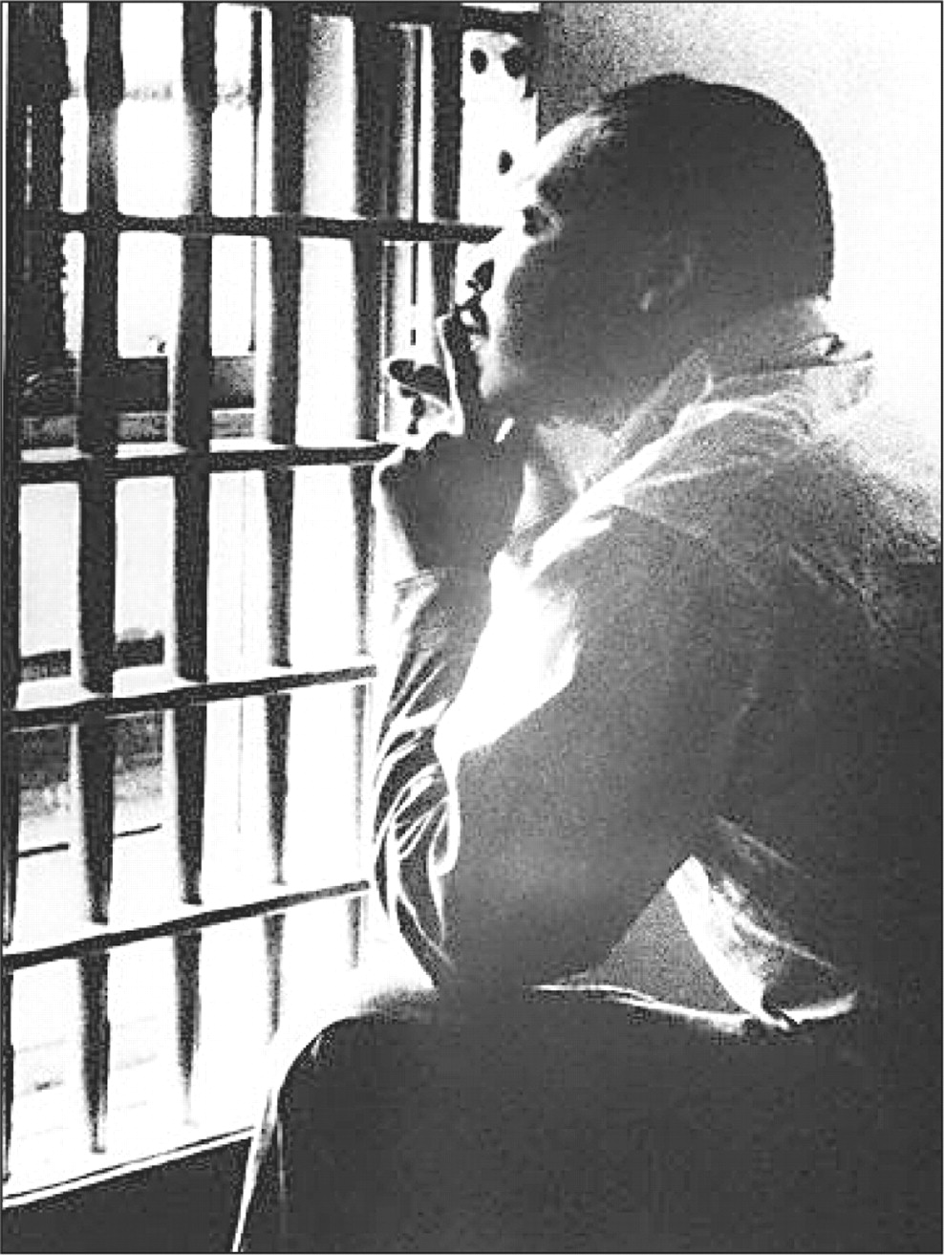
Notes:
Background: Put in jail for Birmingham Jail, marches and calls for segregation were thought unlawful.
Write 3 senteces about what you would be thinking if you were MLK.

Slide 7
Injustice anywhere is a threat to justice everywhere. We are caught in an inescapable network of mutuality, tied in a single garment of destiny. Whatever affects one directly affects all indirectly. Never again can we afford to live with the narrow, provincial "outside agitator" idea. Anyone who lives inside the United States can never be considered an outsider.
Notes:
MLK

Slide 8
This government, the offspring of our own choice, uninfluenced and unawed, adopted upon full investigation and mature deliberation, completely free in its principles, in the distribution of its powers, uniting security with energy, and containing within itself a provision for its own amendment, has a just claim to your confidence and your support. Respect for its authority, compliance with its laws, acquiescence in its measures, are duties enjoined by the fundamental maxims of true liberty
Notes:
GW

Slide 9
No realistic American can expect from a dictator's peace international generosity, or return of true independence, or world disarmament, or freedom of expression, or freedom of religion -or even good business. Such a peace would bring no security for us or for our neighbors. "Those, who would give up essential liberty to purchase a little temporary safety, deserve neither liberty nor safety."
Notes:
FDR

Slide 10
Four score and seven years ago our fathers brought forth on this continent, a new nation, conceived in Liberty, and dedicated to the proposition that all men are created equal.
Notes:
AL

Slide 11
The world will little note, nor long remember what we say here, but it can never forget what they did here. It is for us the living, rather, to be dedicated here to the unfinished work which they who fought here have thus far so nobly advanced.
Notes:
AL

Slide 12
Citizens, by birth or choice, of a common country, that country has a right to concentrate your affections. The name of American, which belongs to you in your national capacity, must always exalt the just pride of patriotism more than any appellation derived from local discriminations.
Notes:
GW

