Slide 2
Notes:
Beginning to 3:27

Slide 3
What is a logical fallacy?

Slide 4
Fallacy
An error in reasoning or logic

Slide 5
Non sequitur: “it does not follow”

Slide 7
Non sequitur:
There is a disconnect between the premise and the conclusion.

Slide 8
Ad hominem
Means “to the man.” Attacks the opponent as a person rather than the argument itself.

Slide 9
AD HOMINEM

Slide 10
Appeal to emotions
Rather than arguing a point, the arguer appeals to emotions of pity, grief, fear, sympathy, relief to persuade a listener.

Slide 11
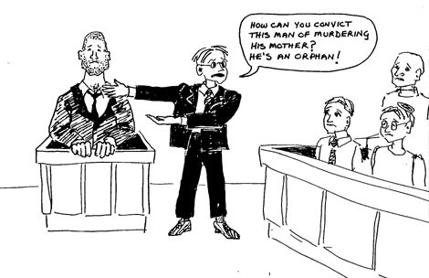

Slide 12
HASTY GENERALIZATION
Drawing a conclusion based on a very small sample size.

Slide 13
Hasty generalization

Slide 14
APPEAL TO AUTHORITY
Arguing that something that is true just because an authority says it when that authority is not an expert on the subject.

Slide 15
Appeal to authority

Slide 16
See how many you can find! (5:50 -
Notes:
Hillary – 6:00 appeal to emotions: granddaughter
Trump – 8:08 hasty generalization? Non sequitur

