Slide 1
Clause Combinations

Slide 2
Decide what the underlined portion of the sentence is: IC or DC
I see something I never noticed before when Aibileen looks down at her page.
Before I was born, she actually picked cotton for a week at Longleaf.
I wish I could hear everything she knows about Constantine, but I’ll wait until we’ve finished her interviews.
I read and reread and take pages to Aibileen; she does the same.
Notes:
I want to show you that you see them all the time. You just don’t notice them. If we know what they’re called. We will avoid making mistakes in our writing.

Slide 3
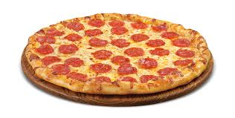
Independent Clause Dependent Clause
ICDC.
I ate pizza because I was hungry.
*There is no comma AFTER an IC.

Slide 4
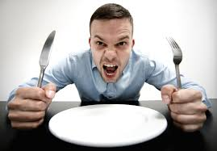
Dependent Clause, Independent Clause
DC,IC.
Because I was hungry, I ate pizza.

Slide 5
Coordinating Conjunction
For
And
Nor
But
Or
Yet
So

Slide 6
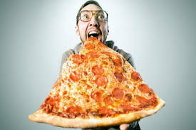
Independent Clause, coordinating conjunction Independent Clause
IC, cc IC.
I was hungry, but I ate pizza.
I wanted pizza but not salad.

Slide 7
Independent Clauses; Independent Clause
IC; IC.
I was hungry; I ate pizza.
I was hungry; the pizza was there.

Slide 8
Independent Clause, Independent Clause

Slide 9
Sentence combining
Get into groups
With your bag, you must make at least 4 sentences. You must have one each of the following.
ICDC
DC,IC
IC; IC
IC, cc IC

