Slide 1
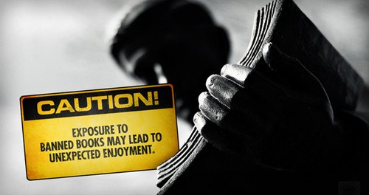
This presentation will discuss banned books and why they are awesome. Proceed with caution…
WARNING!

Slide 2
What Is A Banned Book?
Banned books are ones that have been removed from a library or school curriculum due to its content.
Challenged books are ones that people have requested to be removed from a library or school but remained on the shelves.
Books have been banned since the beginning of time…or the written word.
They are still being banned today.

Slide 3
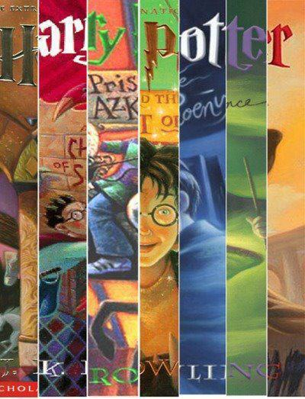
Reasons for Banning…
Promotes witchcraft
Violence
Satanism
Anti-family
Burned in 2002 in New Mexico for being “a masterpiece of satanic deception.” “Harry Potter is the devil and he is destroying people.”

Slide 4
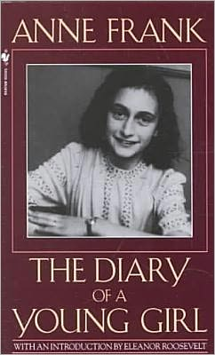
Reasons for Banning…
“A real downer”
Sexual content
Homosexual content

Slide 5
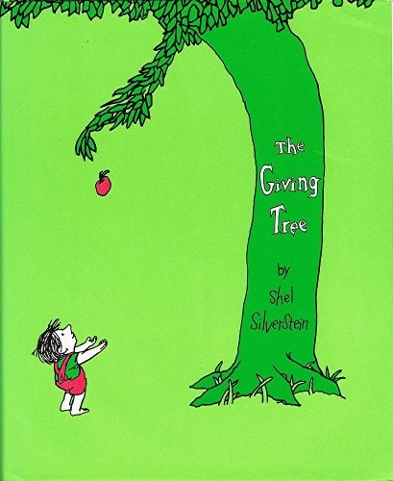
Reasons for Banning…
Sexist
“Criminalized the foresting agency”

Slide 6
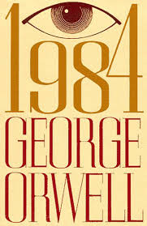
Reasons for Banning…
Banned in USSR under Stalin’s rule for being anti-communist. (You’d have been arrested if you were caught reading it.)
Pro-communist
Sexual content

Slide 7
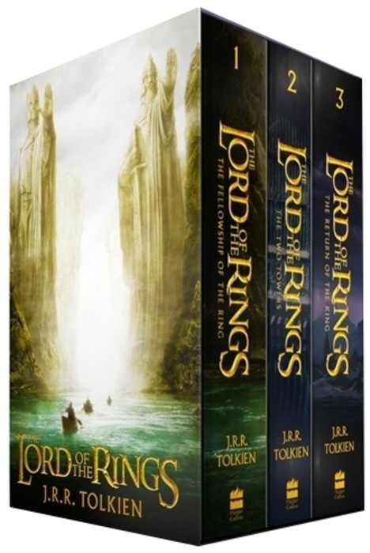
Reasons for Banning…
Irreligious
Satanic
Enjoyed smoking too much

Slide 8
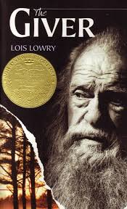
Reasons for Banning…
Infanticide
Mind control
Use of the word “clairvoyance”
Themes of murder, suicide
Promoted adolescent pill-popping

Slide 9
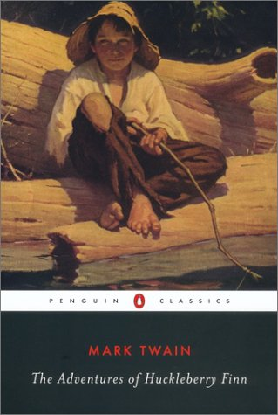
Reasons for Banning…
Racist
Offensive Language
“Trash suitable only for the slums”

Slide 10
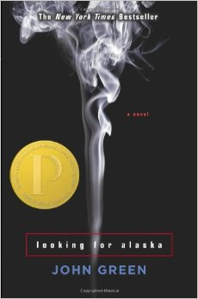
Reasons for Banning…
Language
Sexually explicit
Most Challenged Book of 2015
(John Green has admitted that this book was written with Christian themes.)

Slide 11
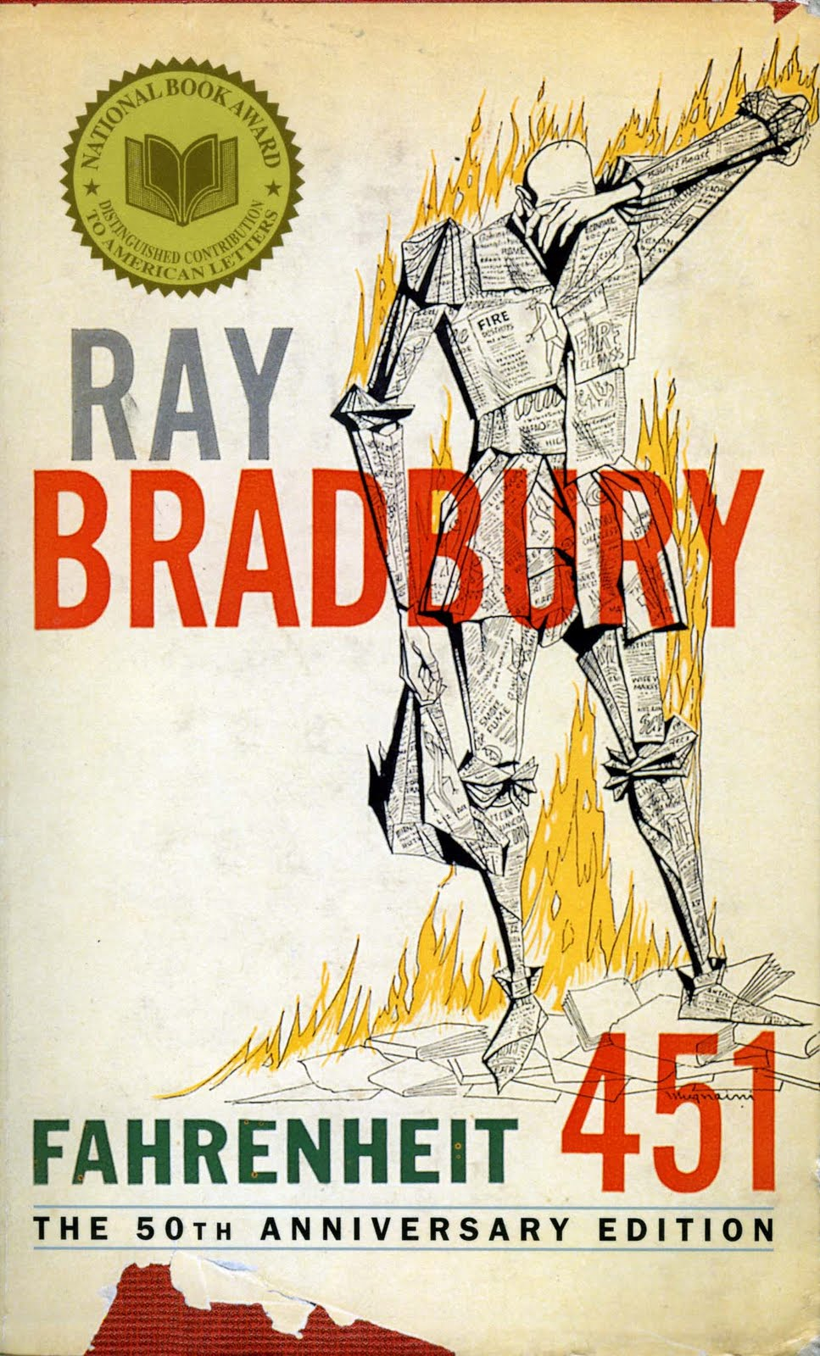
Reasons for Banning…
Language
Burns the Bible

Slide 12
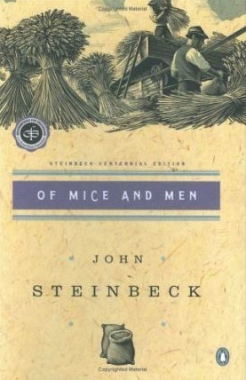
Reasons for Banning…
“Morbid and depressing”
Anti-business
Language
Sexual Content

Slide 13
Timeline of Bannings…
Bannings:
Ireland (1953); Syracuse, IN (1974); Oil City, PA (I977); Grand Blanc, MI (1979); Continental, OH (1980); Scottsboro, AL High School (1983); Alabama High School (1989); Arkansas High School (1989); Florida High School (1991); Ohio High School (1992); Tennessee School District (1994); Illinois High School (1997); Florida School District (1997); Mississippi School District (2002);
Challenges: Greenville, SC (1977); NY School District (1980); St. David, AZ (1981); Tell City, IN (1982); Marion County, WV School District (1988); Illinois Middle School (1988); Michigan High School (1988); Chattanooga, TN (1989); Tennessee School District (1989); Kansas High School (1990); California High School (1991); Texas School District (1990); Pennsylvania High School (1991); Tennessee High School (1991); Virginia High Schools (1991); Iowa High School (1992); Florida School District (1992); California High School (1992); Louisiana School (1992); Arizona High School (1993); Georgia High School (1994); Kansas High School (1995); Minnesota High School (1995); Georgia High School (1995); Virginia High School (1995); Ohio High School (1997); Minnesota High School (1997); California Middle School (1998); Arkansas School (1998); Wisconsin School District (1998-1999); Pennsylvania High School (1999); Michigan High School (2002); Illinois High School (2003); Pennsylvania High School (2006); Iowa High School (2007); Kansas High School (2007); Idaho High School (2015).

Slide 14
2015 Challenge of Of Mice and Men
Challenged in Idaho, 9th Grade
“Neither a quality story nor a page turner.”
Objected to the language and the “negative” and “dark” themes.
School Board voted (4 to 1) to have it remain on the school’s curriculum.

Slide 15
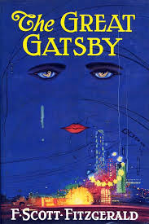
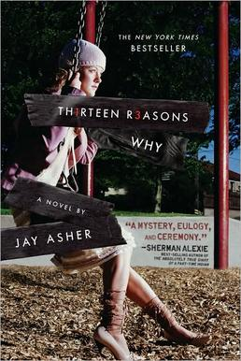
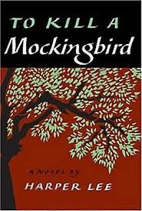
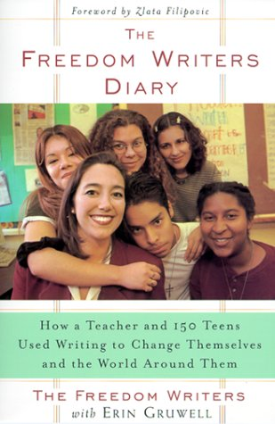
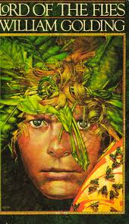
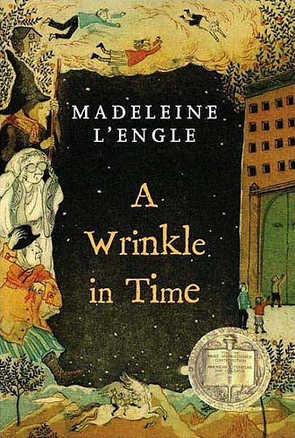
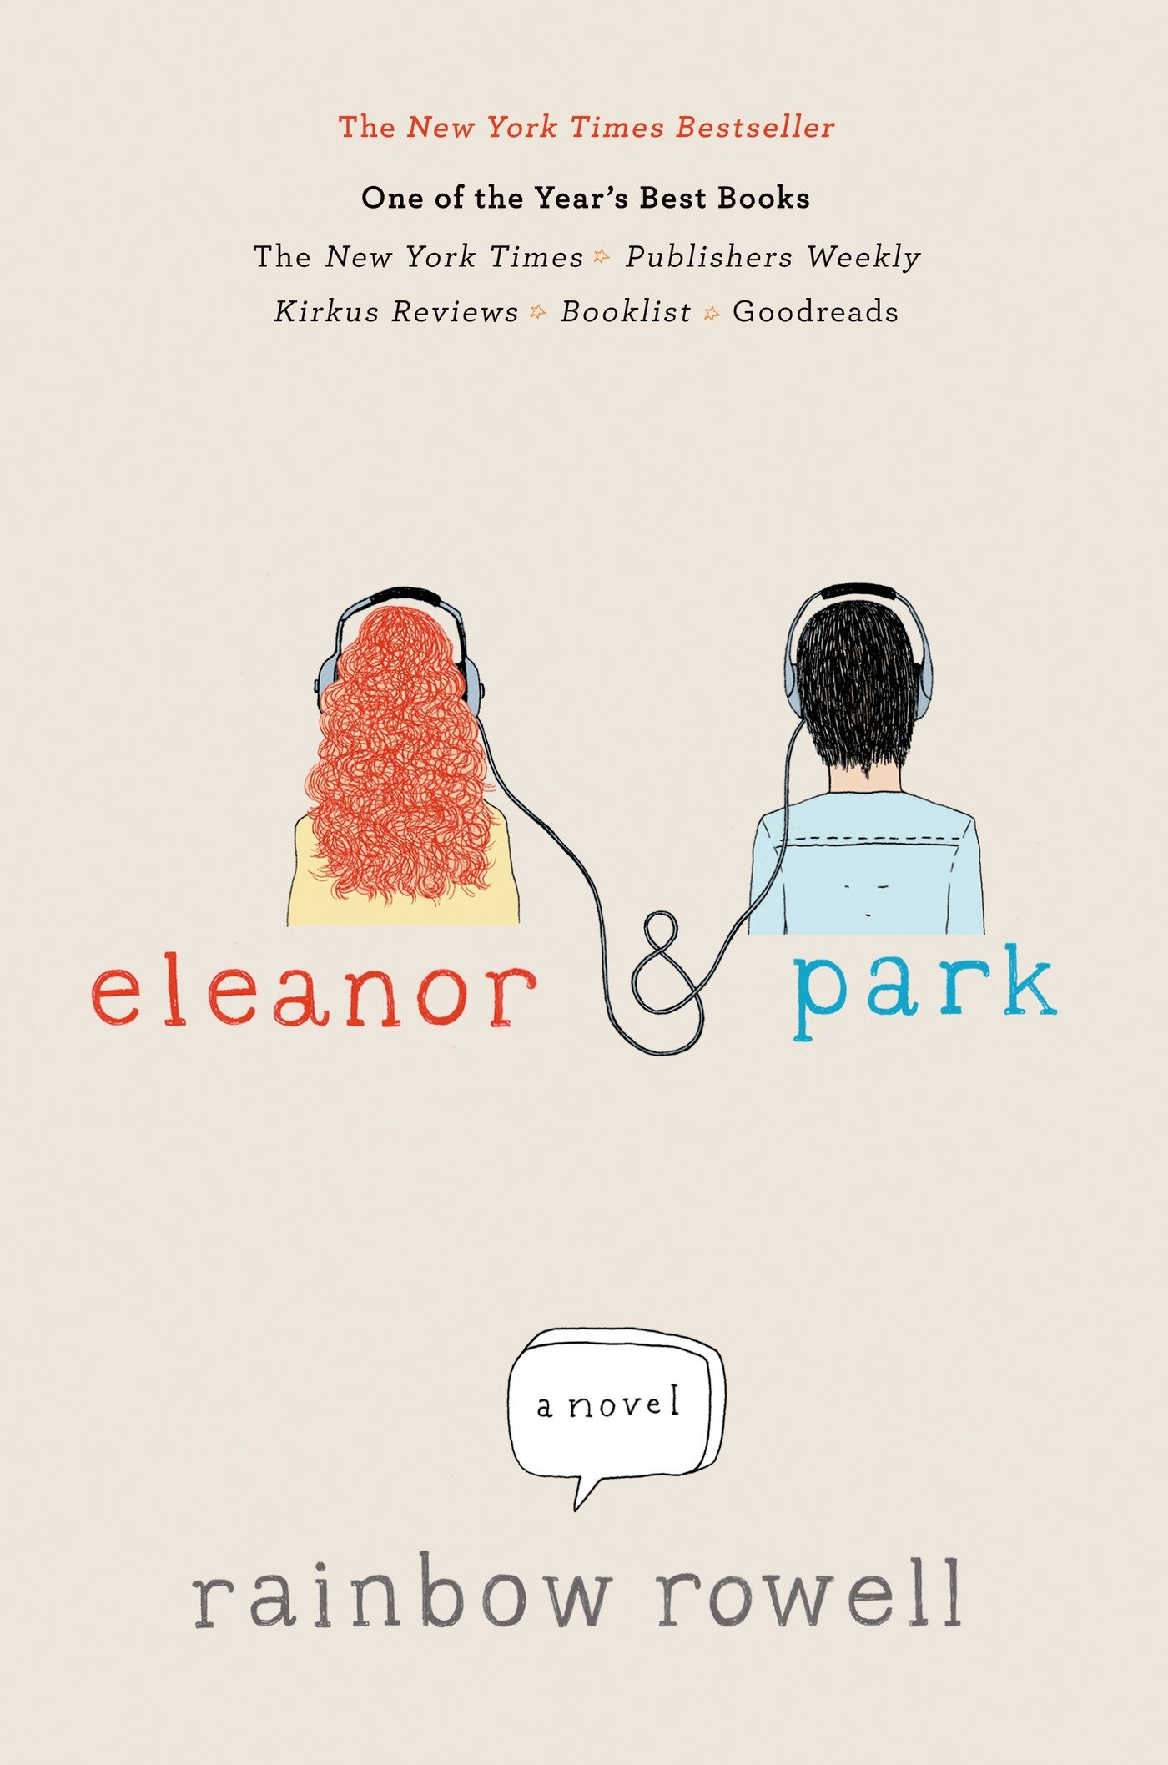
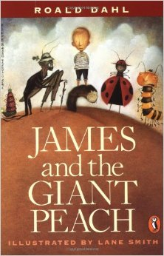
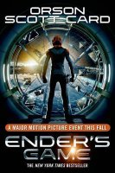
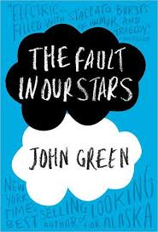
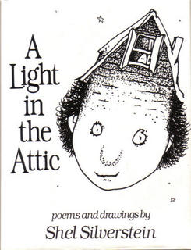
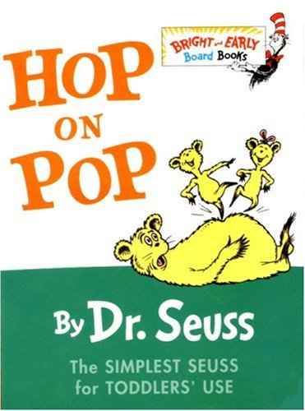
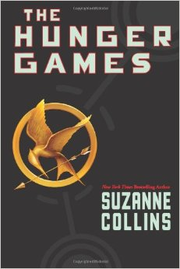
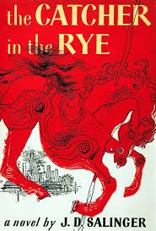
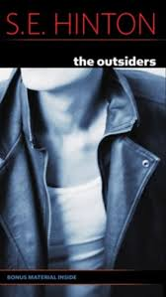

Slide 16
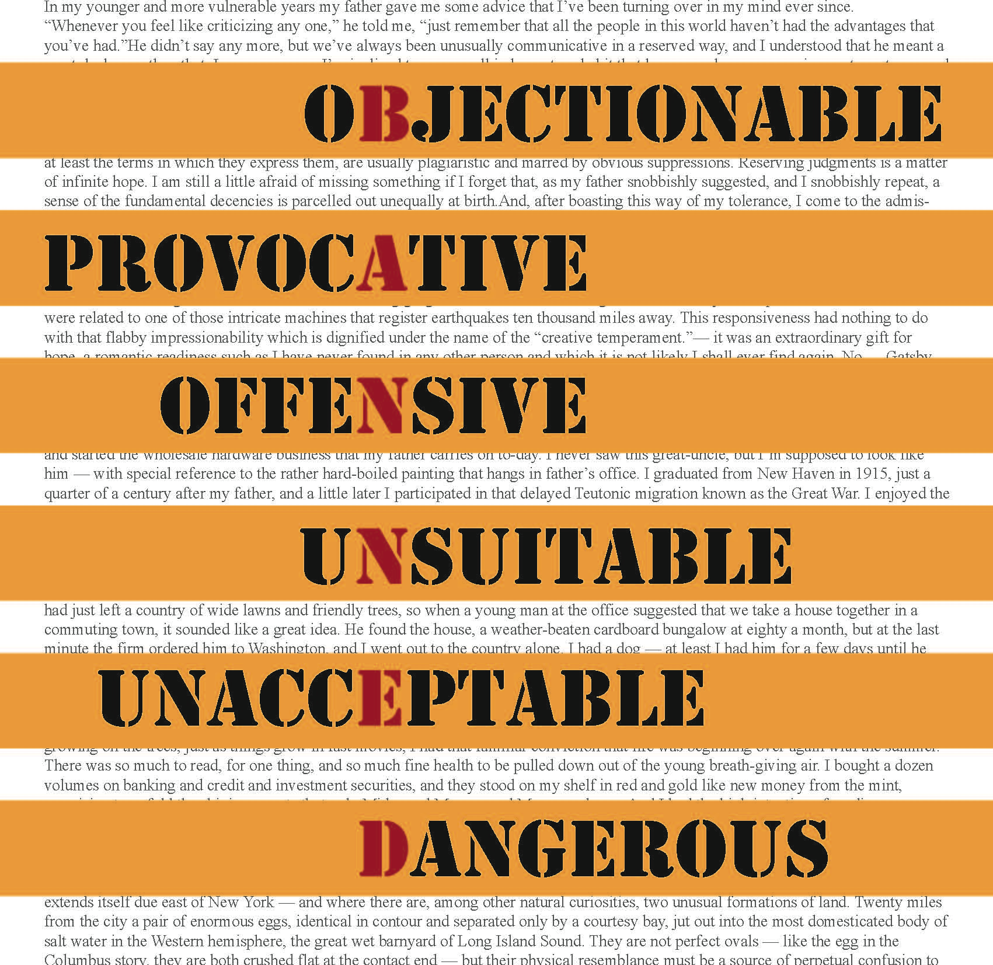
Why Do People Want to Ban Books?
Protect you!
FEAR!

Slide 17
“Yes, books are dangerous. They should be dangerous—they contain ideas.”
Pete Hautman
Ideas
Knowledge
Power!

Slide 18
What do you think?
Should all books be available to everyone?
Or should some be banned?

Slide 19
Risks/Rewards
Does the book teach me something of value?
Do the positives outweigh the negatives?
How do I feel when I read this book?

Slide 20
Self-censoring (Stop it/Skip it.)
No one can force you to read something offensive or uncomfortable.
If you don’t like it, STOP reading it.
Or SKIP over certain parts.
Talk to your parent/guardian or teacher about difficult subject matter.

Slide 21
It’s Your Right!
“Censorship is telling a man he can’t have a steak just because a baby can’t chew it.”
Mark Twain
People have the right to express their opinion.
But you get an opinion too!
You decide what is right for you!

Slide 22
References
http://www.ala.org/bbooks/frequentlychallengedbooks/classics/reasons
https://www.theguardian.com/books/2015/may/07/idaho-parents-profane-of-mice-and-men-banned-schools-john-steinbeck
http://www.latimes.com/books/jacketcopy/la-et-jc-steinbeck-censorship-attempt-idaho-20150602-story.html
https://www.theguardian.com/world/2002/jan/01/books.harrypotter
http://www.ala.org/bbooks/frequentlychallengedbooks/top10#2015

